Slide 1
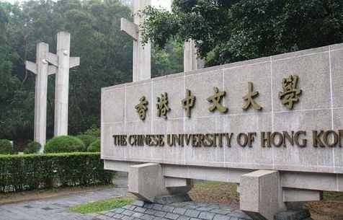


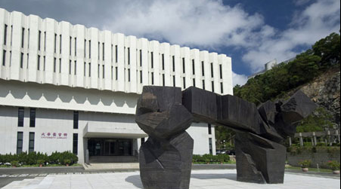
人工智能时代下的软件工程发展趋势
Where is Software Engineering Heading in AI Era?
Michael R. Lyu
Nov 2018

Slide 2
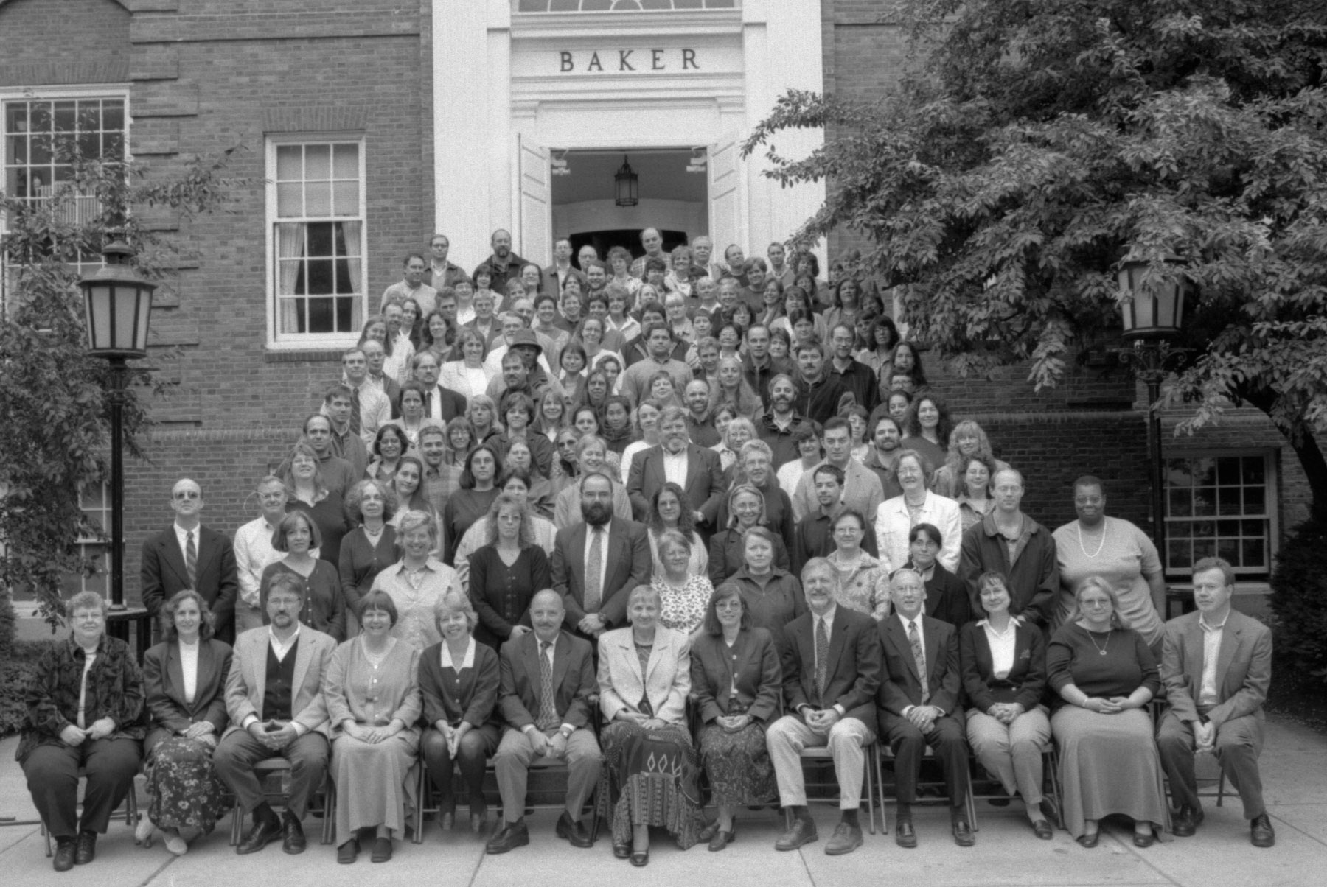
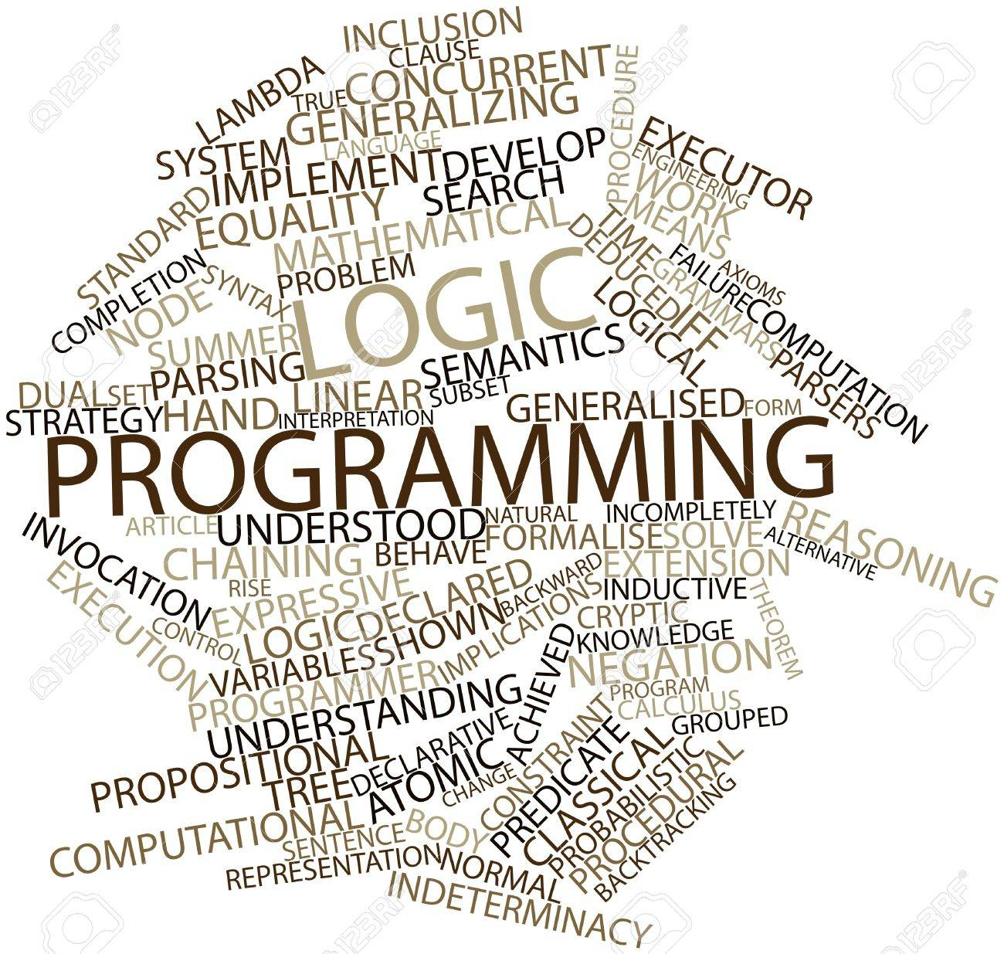
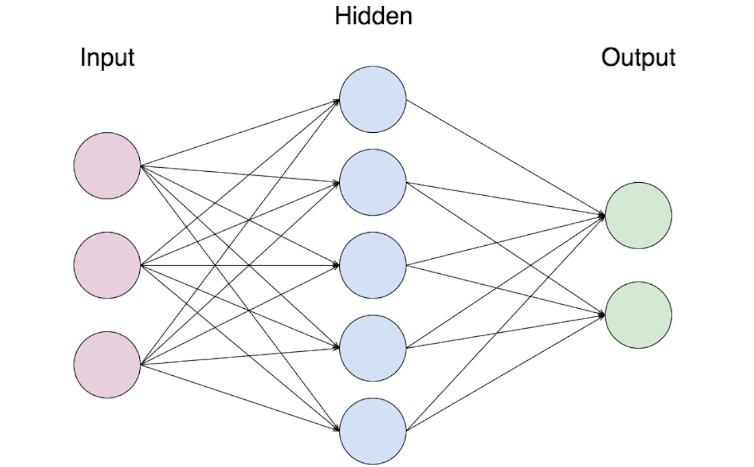
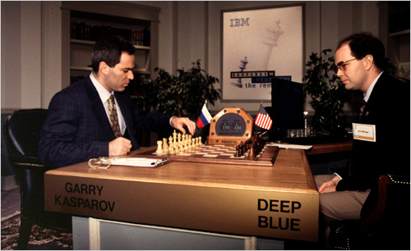
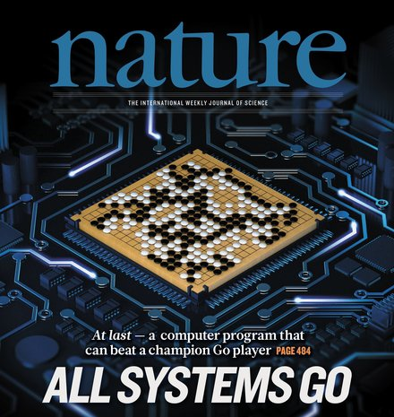
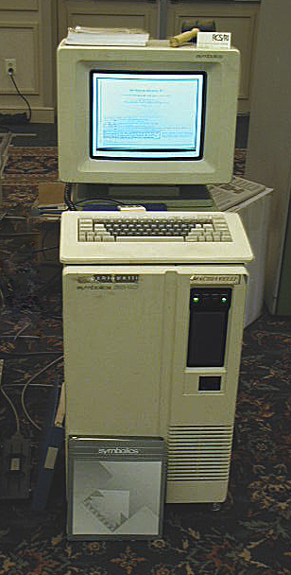
时代背景
Representation
Language of Logic
Basic Structure
Deep Blue vs Kasparov
Go Game
Birth of “AI”
1950
1956
1965
1974
Mid 80’s
1990-2000
2010
2011
2016
Now
Turing test
Artificial
Intelligence
Logic
Programming
Expert
Systems
Neural
Network
Breakthrough
Big Data
IBM Watson
wins on Jeopardy
Alpha Go beats
Lee Sedol
The Age of AI
What is “Intelligence”?
Symbolics Machine
IBM’s Watson

Slide 3
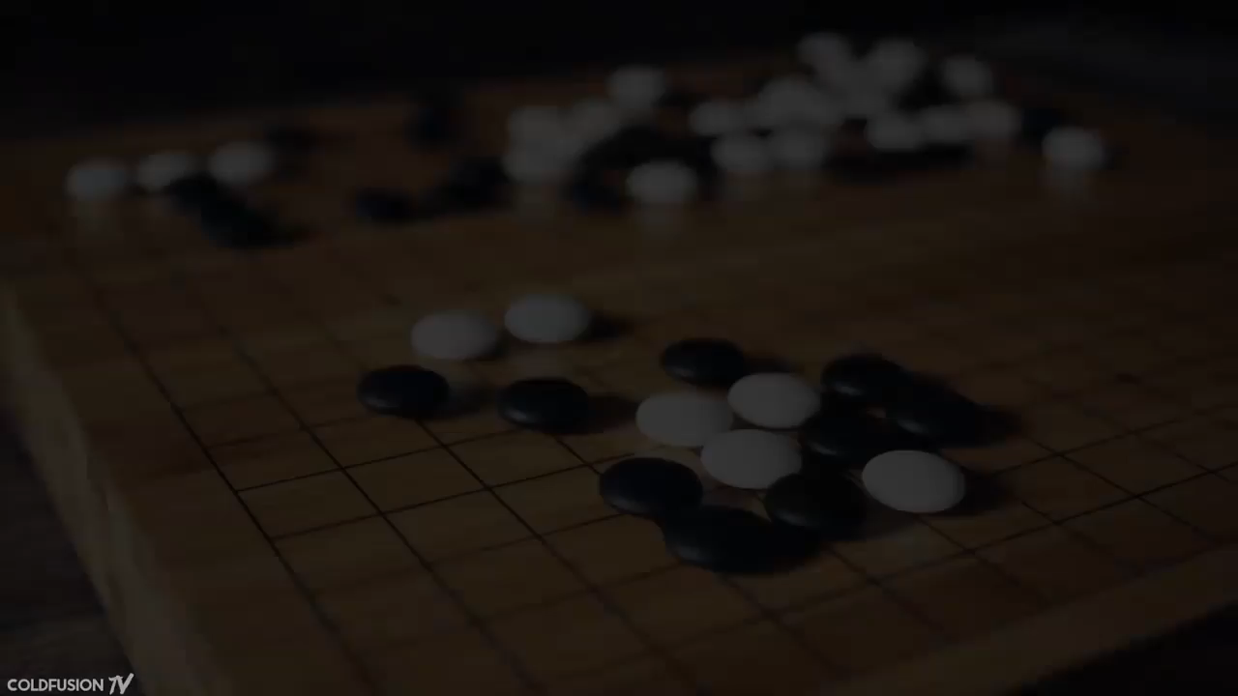
AlphaGo 在人工智能的突破
$$搜索空间巨大{≈10}^{360}$$
Notes:
Game tree complexity = $b^{d}$ Brute force search intractable: where b is a number of possible legal moves and d is a game length
Approximate numbers are: b≈35, d≈80 for chess (10¹²³ different games) and b≈250, d≈150 for Go (10^360 different games). Average multi-core gigahertz processor can do 10^9 operations per seconds so it means that evaluation of all possible moves in Go would take longer than our Universe will exist

Slide 4
IT技术的发展趋势
Machine Oriented: Mainframe [1946] to PC [1974] to Mobile [2007]
Computers took over the world
Connection Oriented: Centralized [1964] to Distributed Systems [2004]; Experimental [1969] to Global Networks [1993]
Internet took over the world
Data Oriented: Super Computer [1976] to Cloud [2006], IoT [1999] and smartphone [2007]; Big Data [2005]
Data took over the world
Intelligence Oriented: Einstein [1905] to Machine Intelligence (Deep Blue [1997] and AlphaGo [2016])
AI is taking over the world
Notes:
Machine Oriented
ENIAC – 1946; Intel 8080 – April 1974; iPhone – June 29, 2007
Connection Oriented
1964 – All that changed with the announcement of the System/360 (S/360) in April, 1964.^{[4]} The System/360 was a single series of compatible models for both commercial and scientific use. The number "360" suggested a "360 degree," or "all-around" computer system.
2004 – Google’s Jeffrey Dean and Sanjay Ghemawat published MapReduce in OSDI.
2005 – Hadoop was created by Yahoo! built on top of MapReduce. It’s goal was to index the entire World Wide Web and nowadays the open-source Hadoop is used by a lot organizations to crunch through huge amounts of data.
1969 – The first successful message on the ARPANET was sent by UCLA student programmer Charley Kline, at 10:30 pm on 29 October 1969, from Boelter Hall 3420. By 5 December 1969, the entire four-node Arpanet was established.
1989/3/12 – Tim Berners-Lee submitted a proposal for a distributed information system at CERN. On April 30, 1993, the CERN directorate released the source code of WorldWideWeb into the public domain. Several versions of the software are still available on the web.
Data Oriented
1976 – Cray delivered the 80 MHz Cray 1, and it became the most successful supercomputer in history.
August 2006, Amazon introduced its Elastic Compute Cloud.
2005 – Roger Mougalas from O’Reilly Media coined the term Big Data for the first time, only a year after they created the term Web 2.0. It refers to a large set of data that is almost impossible to manage and process using traditional business intelligence tools.
Intelligence Oriented
Deep Blue was then heavily upgraded (unofficially nicknamed "Deeper Blue") and played Kasparov again in May 1997, winning the six-game rematch 3½–2½, ending on 11 May. Deep Blue won the deciding game six after Kasparov made a mistake in the opening, becoming the first computer system to defeat a reigning world champion in a match under standard chess tournament time controls.
The Annus mirabilis papers (from Latin annus mīrābilis, "extraordinary year") are the papers of Albert Einstein published in the Annalen der Physik scientific journal in 1905. These four articles contributed substantially to the foundation of modern physics and changed views on space, time, mass, and energy. The annus mirabilis is often called the "miracle year" in English or Wunderjahr in German.
AlphaGo versus Lee Sedol, or Google DeepMind Challenge Match, was a five-game Go match between 18-time world champion Lee Sedol and AlphaGo, a computer Goprogram developed by Google DeepMind, played in Seoul, South Korea between 9 and 15 March 2016.

Slide 5
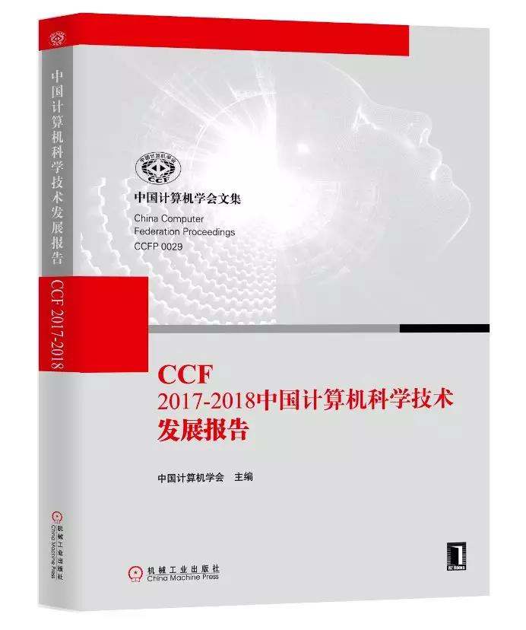
AI与系统软件融合
2018年10月，CCF发表综述文章：
AI for Systems:
机器学习安全及其在系统安全中的应用
基于AI的系统软件优化与缺陷检测
Systems for AI:
机器学习系统的支撑、拓展与优化技术
类脑神经网络计算系统软件

Slide 6
用AI解决软件工程问题
需求分析自动化
软件问题排序
Classification
Topic Modeling
NLP
评论数据
代码分析自动化
代码缺陷检测
自动写代码
RNN with Attention
Classification
CNN
代码数据
Classification
Deep Learning
软件测试自动化
机器学习
操作数据
故障诊断自动化
日志打点自动化
日志分析自动化
Classification
Deep Learning
日志数据

Slide 7
用AI解决软件工程问题
需求分析自动化
软件问题排序
Classification
Topic Modeling
NLP
评论数据
代码分析自动化
代码缺陷检测
自动写代码
RNN with Attention
Classification
CNN
代码数据
Classification
Deep Learning
软件测试自动化
机器学习
操作数据
故障诊断自动化
日志打点自动化
日志分析自动化
Classification
Deep Learning
日志数据

Slide 8
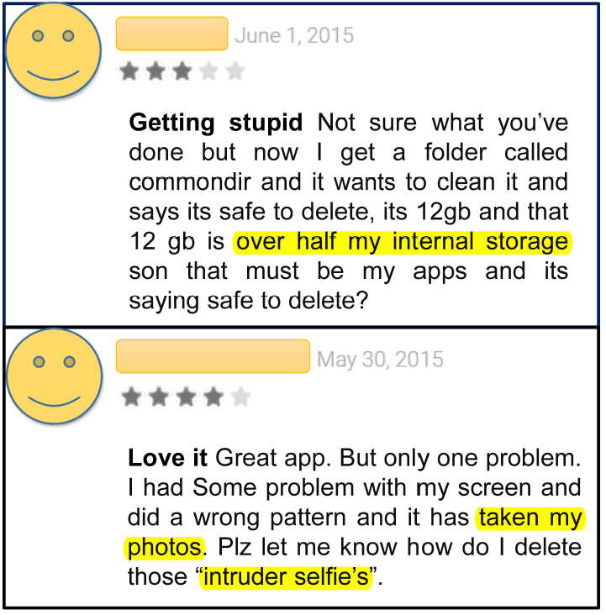



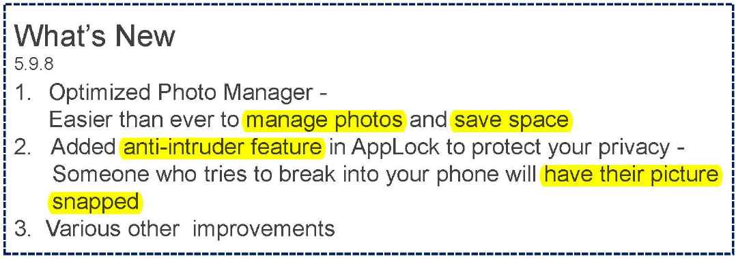



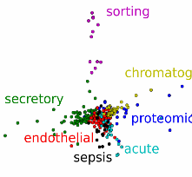
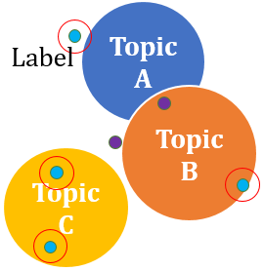

需求分析自动化
2,800,000 apps
2,200,000 apps
669,000 apps
Changelog
Topic Detection
Model
Topic
Interpretation
Review
Recommendation
Preprocessing
Detecting
Issues
User Reviews
Lowercase
Information retrieval
Lemmatization
Noise filtering
Phrase extraction
Clustering
User sentiment analysis
Topic modeling
Similarity measurement

Slide 9

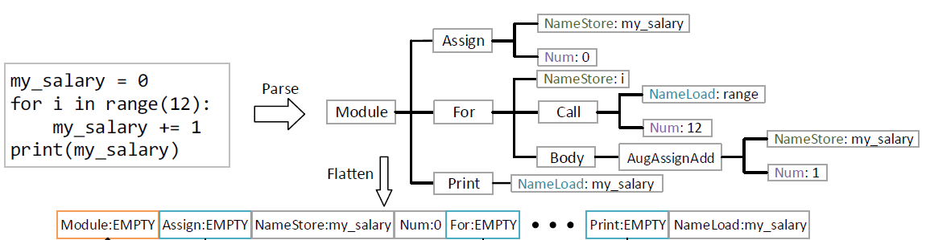

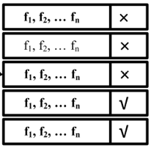
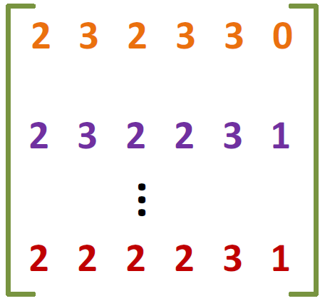
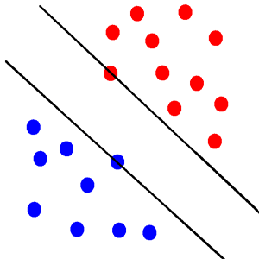
代码分析自动化
源代码分析：AST树状结构
Data Collection
Preprocessing
Feature Extraction
Machine Learning Model
Intelligent Software Tools
Source code
Bug reports
Change histories
Labeling
Filtering
Parsing
Classification
Generation
Recommendation
Feature vectors
Word embeddings

Slide 10

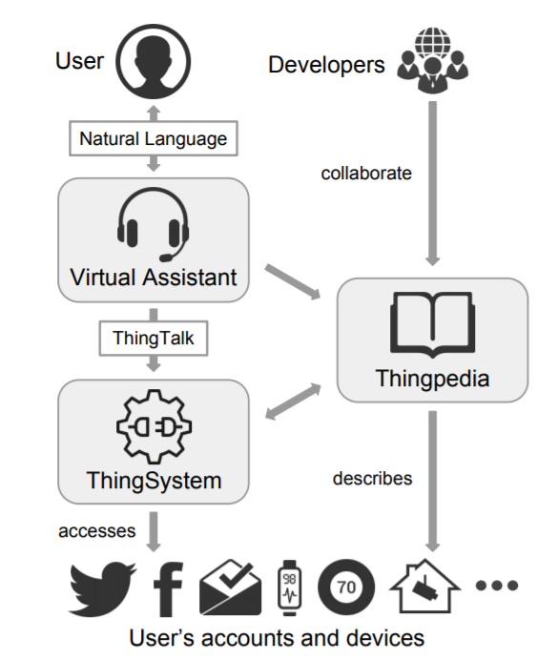
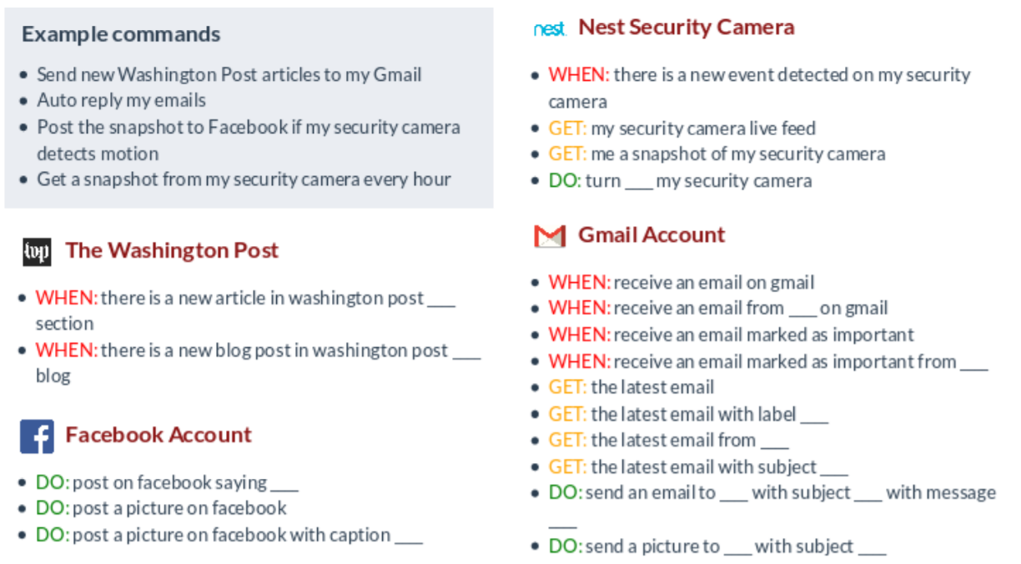
自动编写代码是否可行？
斯坦福大学Monica Lam教授团队开发的Almond
将自然语言转变为机器（安卓等）指令
https://almond.stanford.edu/research

Slide 11
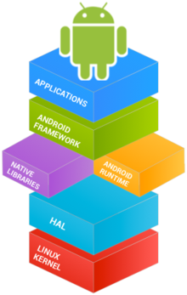

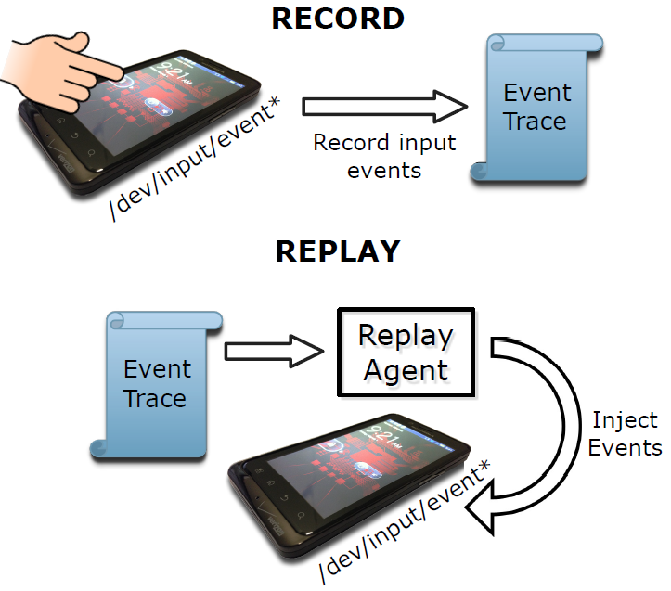
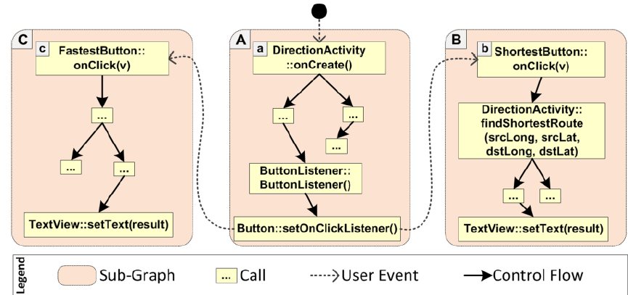
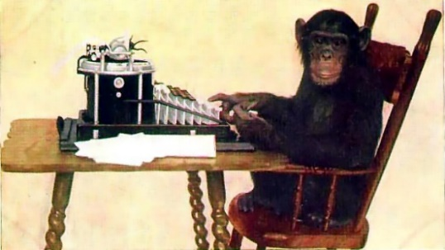
软件测试自动化
测试挑战（以安卓系统为例）
多功能
多用户
多场景
传统方法已不能满足需求
随机测试
录放测试
符号执行

Slide 12
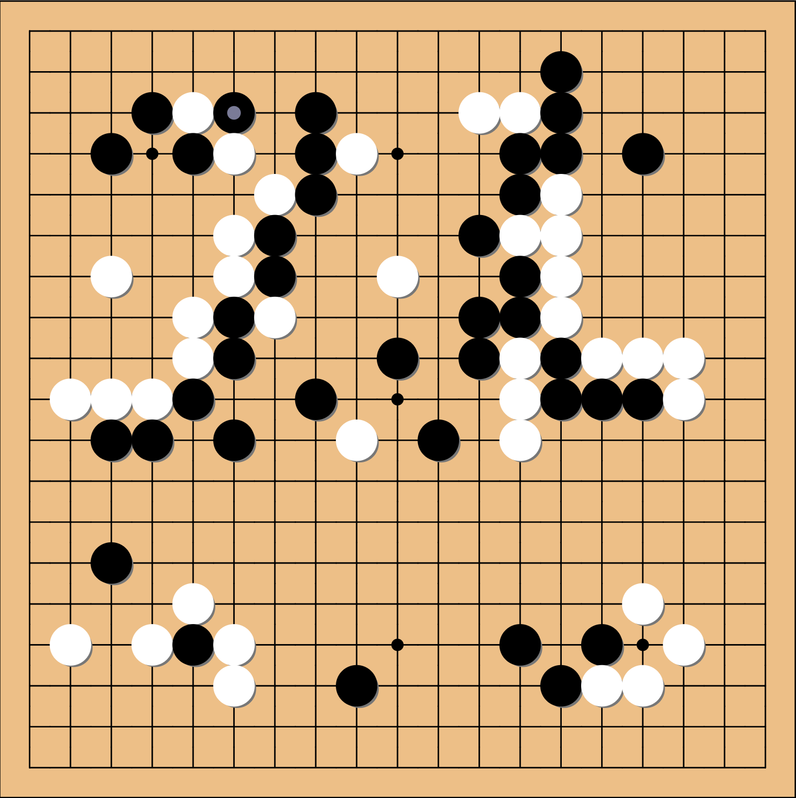
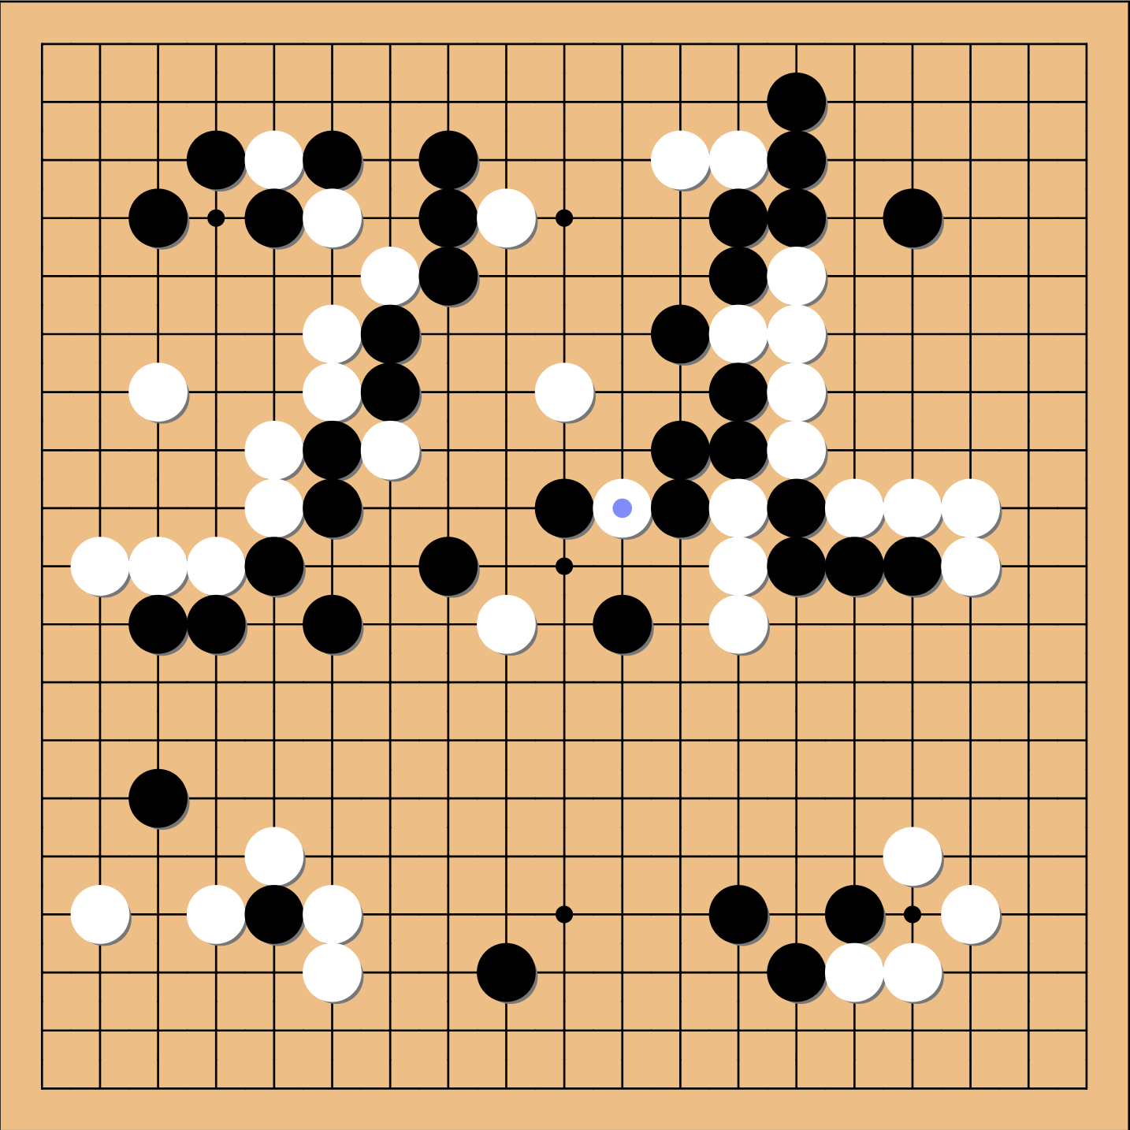
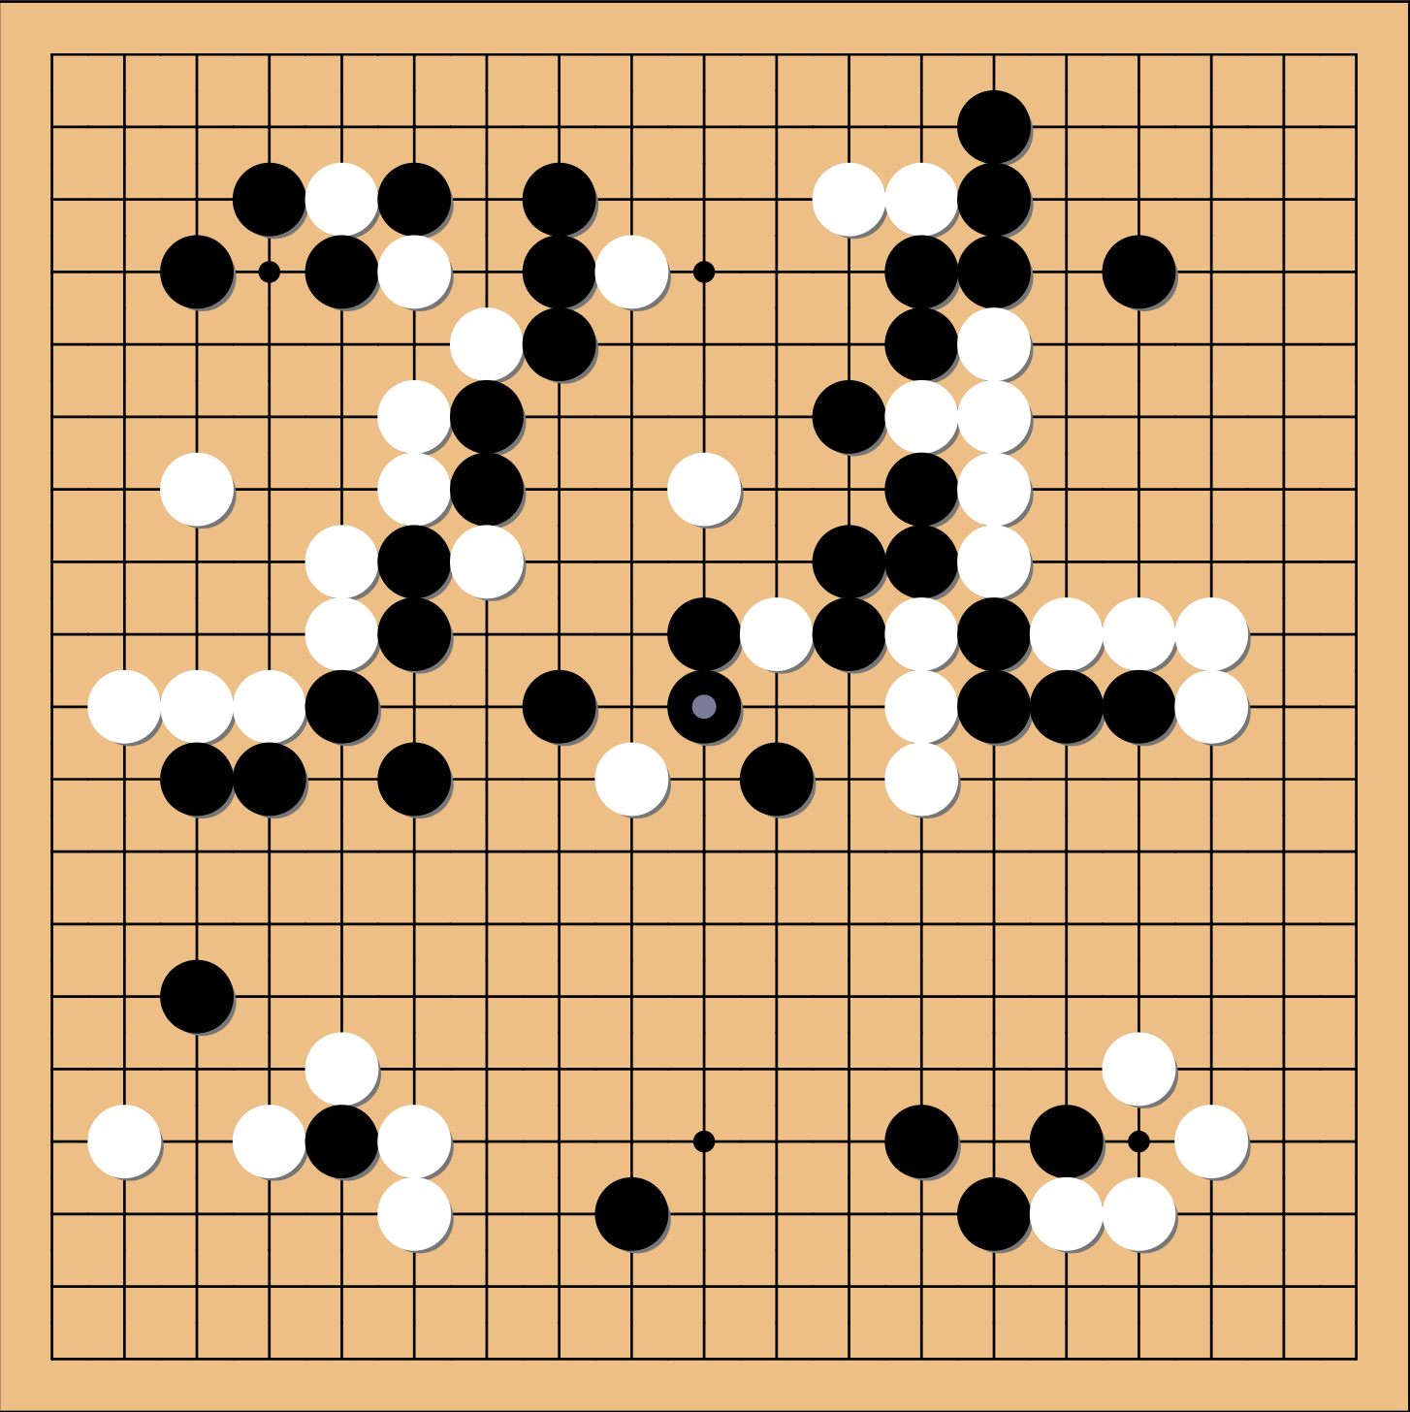

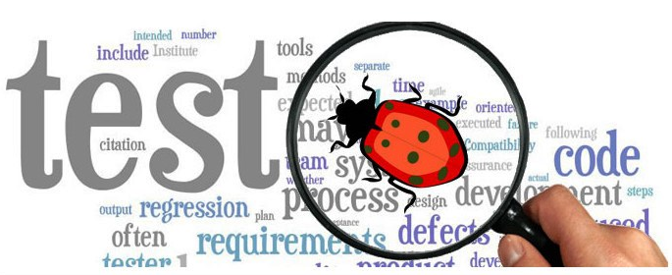
Machine Learning Fault Removal
In Game 4, Lee Sedol chose to play a type of extreme strategy which triggered AlphaGo’s wired behaviors and thus losing a game.
A corner case input to cause AlphaGo’s Deep Learning model to behave incorrectly.
Currently lack of rigorous methods to diagnose the robustness of a Deep Learning model.
Notes:
Lee played an unexpected play at white 78 which made AlphdGo to respond poorly on move 79.

Slide 13
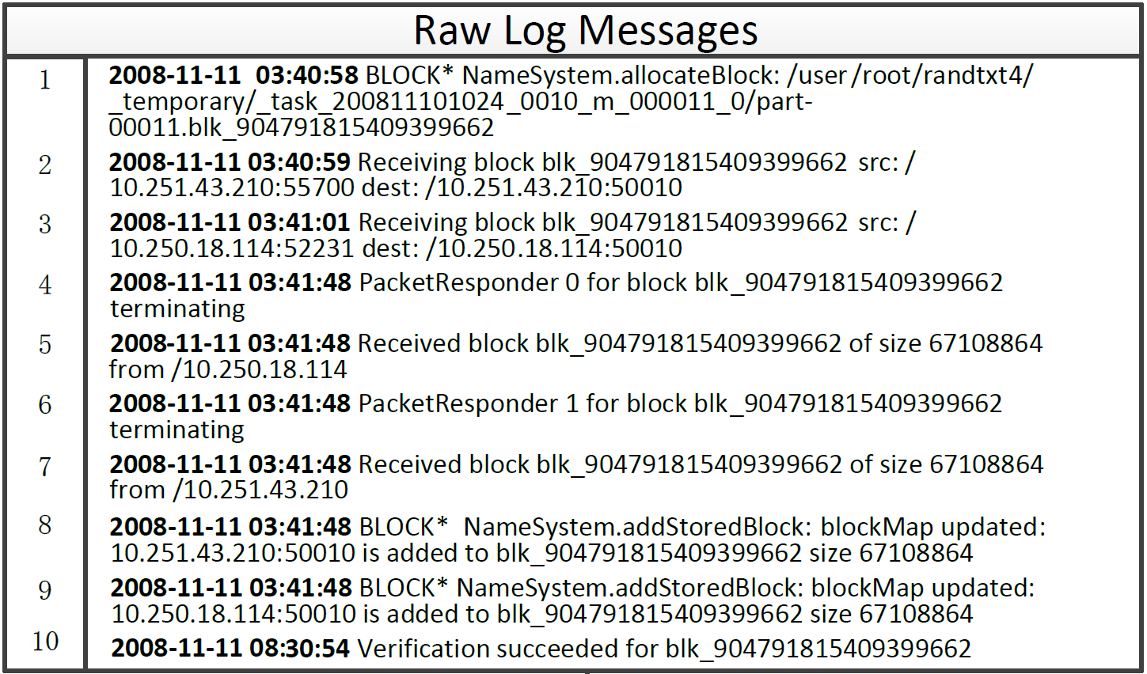
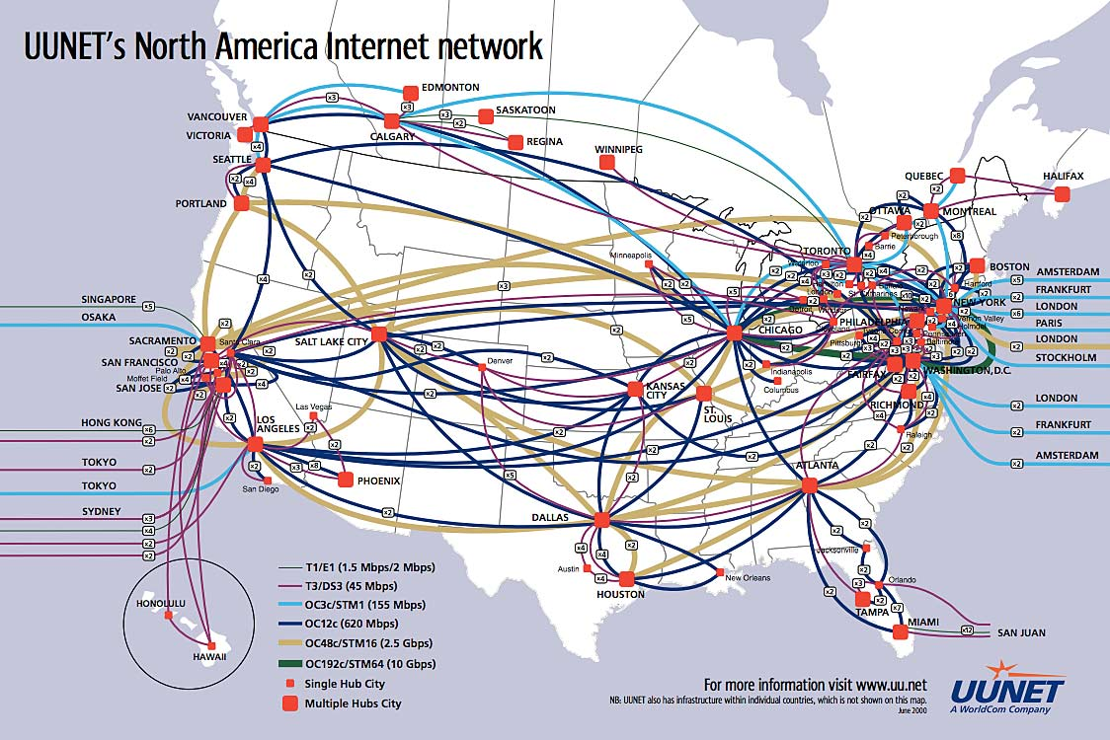


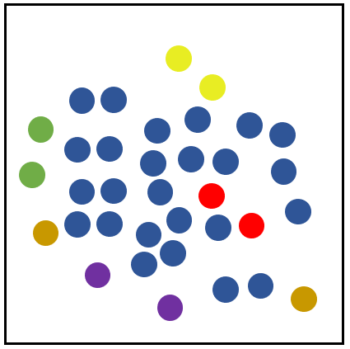

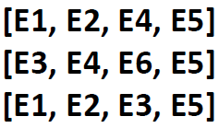
故障诊断自动化
Data Collection
Preprocessing
Feature Extraction
Machine Learning Model
Log Management and
Applications
Clustering
Classification
Outlier Detection
Large
Systems
Log Generation
Log Parsing
Event Count Vector

Slide 14
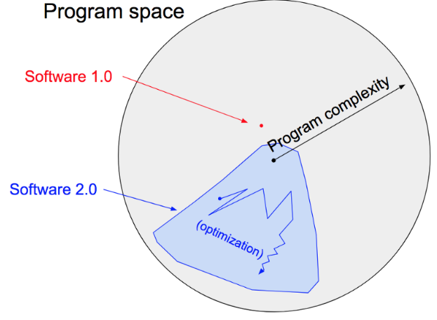
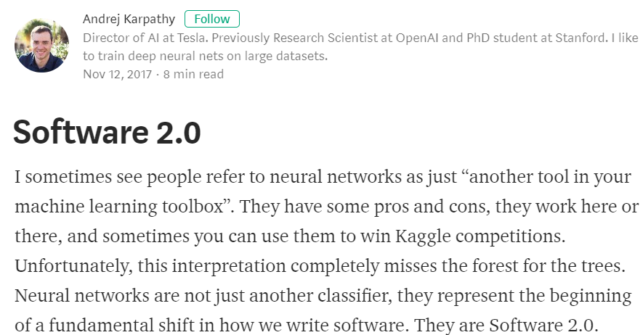
SE for AI: 软件2.0
“Code written by an optimization, commonly in the form of neural network training.”
https://medium.com/@karpathy/software-2-0-a64152b37c35

Slide 15

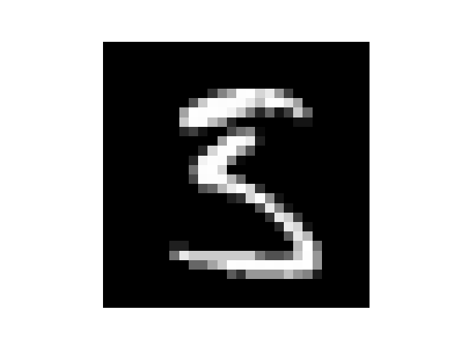
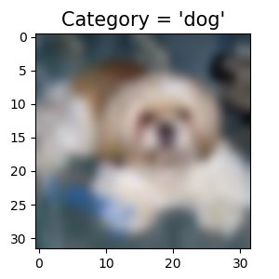
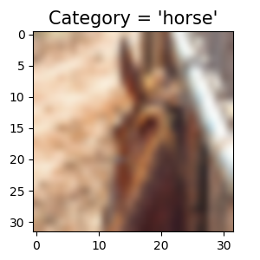
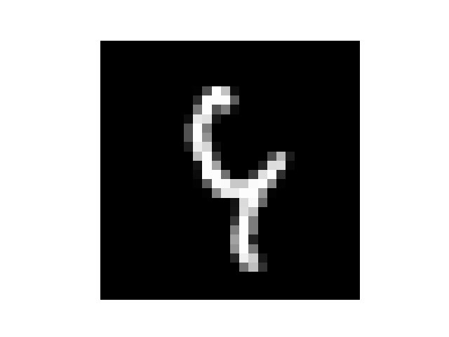

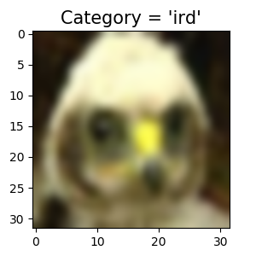
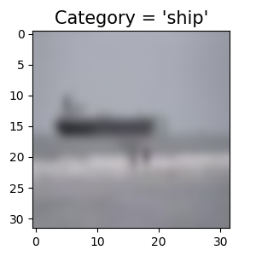
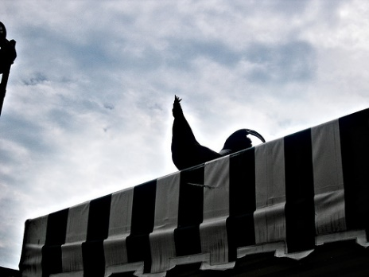
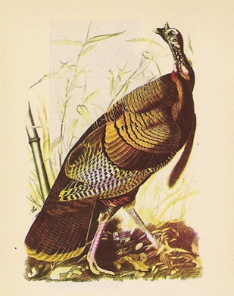
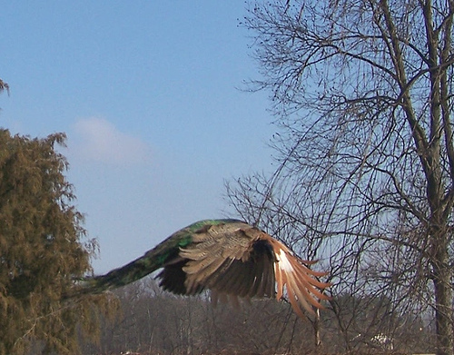
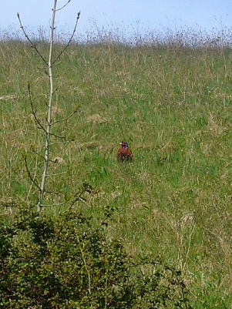
软件2.0面临的可靠性问题
如何定义正常（valid）的输入数据？
通用Benchmark数据准确率很难达到100%
MNIST
CIFAR-10
ImageNet

Slide 16
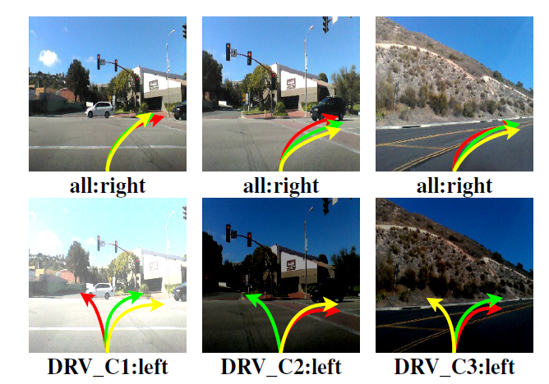
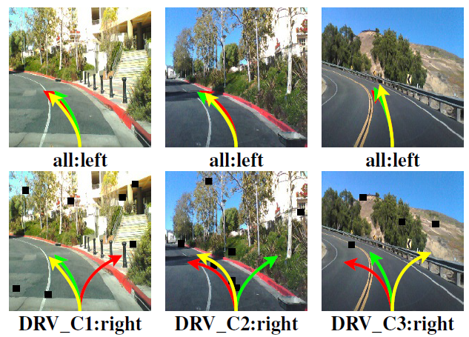
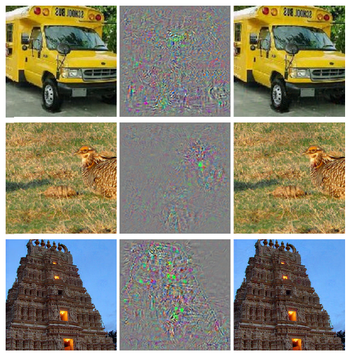

软件2.0面临的安全性问题
黑盒攻击
白盒攻击
[Pei’17]
[Szegedy’13]
[Eykholt’18]
[Szegedy’13] Szegedy, et al. "Intriguing Properties of Neural Networks." arXiv,2013
[Pei’17] Pei, et al. "DeepXplore: Automated Whitebox Testing of Deep Learning Systems" SOSP, 2017
[Eykholt’18] Eykholt et al., Robust Physical-World Attacks on Deep Learning Visual Classification, in CVPR 2018.

Slide 17
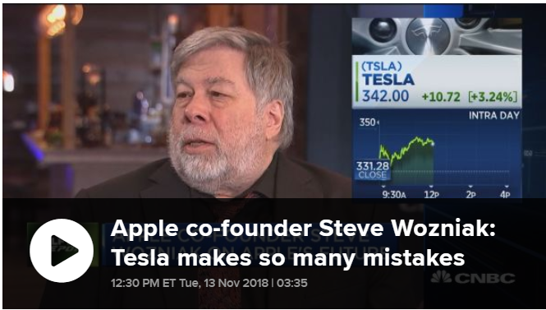
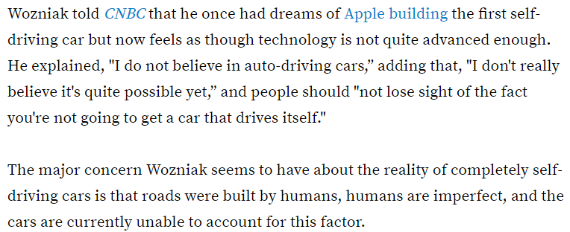
争议和机会
http://www.thedrive.com/news/24921/apple-co-founder-steve-wozniak-doesnt-believe-in-self-driving-cars

Slide 18
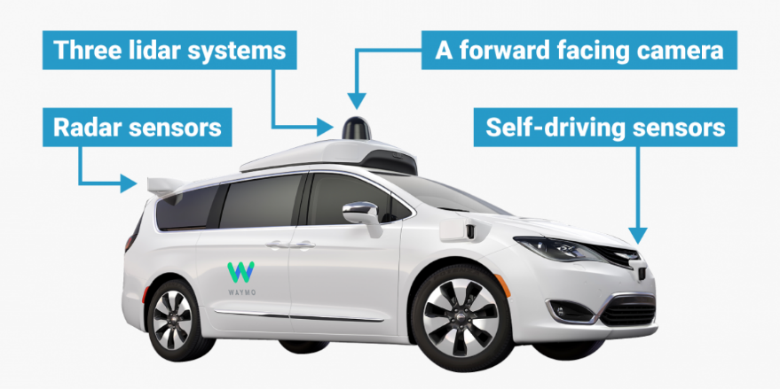



从工程角度看AI可靠性
当前的研究热点
数据采集
模块
预处理模块
CNN模型
特征
数据
概率
数据
原始数据
规则数据
$$\left[\begin{aligned}f \left(K_{1},X\right) \\ … \\ f (K_{n},X)\end{aligned}\right]$$
$$Σ$$
$$\left[\begin{aligned}1 \\ … \\ p\end{aligned}\right]$$
分类结果
卷积层
分类器
软件2.0的可靠性范畴

Slide 19


举例1：攻击防御 or 异常检测？
Adversarial Training对特定的攻击防御效果很好
对未见过的图像（超出S 范围）依然效果很差
如传统的图像变换（如放大、缩小）
识别成功率及低
核心挑战是模型（软件）输入复杂度太高

Slide 20



异常输入数据检测
当输入异常时，模型不应输出或传递其结果
检测方式：
输入数据偏离训练数据分布

Slide 21





举例2：Ensemble vs容错?
N-version Models
Model 1
$$y_{1}$$
$$x$$
$$y_{2}$$
Decision Algorithm
$$y$$
Model 2
$$y_{n}$$
…
Model N
Experimental Setting |  |  |  | Failure Rate | Failure Rate with Random Data Perturbations
Dataset | Factor | Network | Model Accuracy
CIFAR-10 | Default Randomness | ResNet18 | 91.67% | 7.01% | 24.5%
 |  |  | 90.94%
 |  |  | 91.25%
 | Different Networks | ResNet18 | 91.67% | 6.9% | 25.26%
 |  | GoogLeNet | 91.50%
 |  | DenseNet121 | 90.14%
 | Different Data | ResNet18 | 91.67% | 6.79% | 18.45%
 |  |  | 90.26%
 |  |  | 90.67%

Slide 22

软件2.0的可靠性研究思路
事前
防错
规范的软件开发流程
事中
容错
Checkpoint and Recovery
N-version Programming
事后
除错
故障诊断和代码改进

Slide 23


其它软工问题：性能、产权保护等
客户端运行AI是趋势

Slide 24





其它软工问题：性能、产权保护等
release model
Company
(model owner)
1. reverse
engineer
Client
客户端运行AI是趋势
2. pirate
structure piracy
parameter piracy
Pirate Model
Attacker
ground truth 2
Model (CIFAR-10) |  | Performance |  |  | Overhead
 |  | Accuracy | Size (MB) | Time (us) | Size | Time
GoogLeNet | Original | 90.83% | 2.51 | 17.85 | - | -
 | Obfuscated | 90.92% | 2.49 | 7.01 | -1% | -63%
ResNet | Original | 90.94% | 43.36 | 10.50 | - | -
 | Obfuscated | 91.04% | 11.38 | 5.17 | -74% | -51%
DenseNet | Original | 90.14% | 4.24 | 35.53 | - | -
 | Obfuscated | 90.31% | 4.21 | 5.52 | -1% | -84%
intermediate output
ground truth 1
real label
other layers
back propagation
obfuscation
Student
Network
(simulator)
Teacher Network
(original block)
input

Slide 25
总结：AI时代下的软件工程发展趋势
基础研究支撑
软件工程智能化
软件2.0工程化

Slide 26
谢谢各位！

